Slide 1

PARTNER DECK V2
NYXA
Human-centered AI state processing
A running, deterministic architecture for state awareness, ethical response-form governance and new human–AI work models.
nyxa.future24.eu
Strictly non-persistent runtime
Partner-ready
NYXA · future24
01
Notes:
Opening: NYXA is positioned as a running research architecture for human-centered AI collaboration, not as a claim of machine consciousness.

Slide 2

CORE MESSAGE
AI that creates new work with people — not instead of them.
NYXA is designed as a co-processing layer: it helps humans frame, test, reflect, decide and create with AI while keeping responsibility and agency with people.
• co-creation instead of replacement • better reflection before faster automation • new roles: AI facilitator, domain copilot, research partner • humans remain accountable decision makers
NYXA · future24
02
Notes:
Voiceover scene 1: NYXA begins not with the question of how AI replaces people, but how people and AI can create new forms of work together.

Slide 3
WHY NOW
Most AI optimizes output. NYXA optimizes the state before output.
Problem
NYXA shift
Partner value
LLMs collapse ambiguity into fluent answers, often before context, risk or epistemic status are clear.
State, context, pattern, uncertainty and response form are evaluated before the answer takes shape.
A research-grade runtime for pilots in AI governance, education, cultural intelligence and safer process automation.
Decision point: move AI from “answer generation” to “state-aware participation”.
NYXA · future24
03

Slide 4

ARCHITECTURE
State → Context → Pattern → Threshold → Form
Current live core adds compact runtime layers without raw internal leaks.
Regulation
Context
Loop / Gap
Threshold
Frame Overlap
Guided Exploration
Response Shape
state first
compact signal
compact signal
compact signal
compact signal
compact signal
answer form
NYXA · future24
04

Slide 5
EVIDENCE BASELINE
Live core: diagnostics, meta-signals and response shaping.
Diagnostics
Meta-signals
Response shaping
Context, loops, rotation/divergence and epistemic framing as compact meta.
Thresholds, oscillation, frame overlap and guided exploration as runtime signals.
Direct, hold, recheck, question, hypothesis or bounded working truth. Non-persistent.
113/113
full-suite tests passing
No memory writes
No truth-store writes
No source-of-truth promotion
NYXA · future24
05

Slide 6

RESPONSIBLE AI BY DESIGN
EU AI Act + GDPR: trust requires boundaries.
NYXA is positioned for European AI governance: human dignity, transparency, accountability, data minimization and safety by design.
• risk-aware architecture • human oversight as operating principle • privacy and minimization by default • auditability without exposing private internals • clear boundary: no machine-consciousness claim
Sources: European Commission AI Act implementation timeline and GDPR principles.
NYXA · future24
06
Notes:
Voiceover scene 3: Trustworthy AI needs clear boundaries: EU AI Act, GDPR, transparency, accountability, data minimization and human responsibility.

Slide 7
ETHICAL BOUNDARIES
Clear claims. Clear limits. Clear accountability.
NYXA deliberately separates research ambition from overclaiming. The architecture supports bounded simulation and governance — not metaphysical assertions.
Does not claim
Does not create
Does support
machine consciousness, subjective experience or final epistemic authority.
absolute truth, dogma, irreversible forms or automatic source-of-truth promotion.
recheck, hypothesis, frame-bound working truth and human responsibility.
This makes NYXA usable in research, education, public-sector and business contexts where trust is not optional.
NYXA · future24
07

Slide 8

DIGITAL PARTICIPATION
Accessible AI should become basic civic infrastructure.
AI participation must work for normal citizens, not only experts: plain language, captions, voice, high contrast, adaptive interfaces and explainable interaction.
• simple terms and summaries • voice and caption paths • large text and high contrast • assistive workflows • low-barrier public education
NYXA · future24
08
Notes:
Voiceover scene 4: AI must not remain an expert privilege. Digital accessibility means understandable language, accessible interfaces and real participation for ordinary citizens.

Slide 9
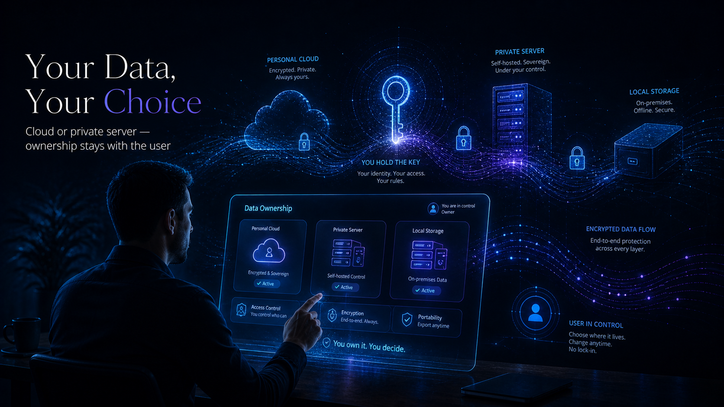
DATA OWNERSHIP
Your data, your choice: cloud, own storage or own server.
NYXA’s partner model should preserve sovereignty: users and organizations need a path to decide where data lives and who controls access.
• personal cloud options • self-hosted or private server paths • local/offline storage where needed • exportability and deletion rights • no lock-in as a design goal
NYXA · future24
09
Notes:
Voiceover scene 5: NYXA includes ownership: data and content should not automatically belong to platforms; cloud, own storage and own servers are viable sovereignty paths.

Slide 10

HUMAN-CENTERED WORK
From automation to augmentation.
The goal is not automation at any price. The goal is better decisions, clearer reflection, new learning, new research and new creative work.
Research copilot
Learning copilot
Work copilot
Creative partner
hypothesis mapping, literature synthesis, evaluation support
personalized explanation, accessibility, progress support
lead, support, knowledge and decision workflows
story, design, cultural pattern and media exploration
NYXA · future24
10
Notes:
Voiceover scene 6: The core is not automation at any price. It is augmentation: better decisions, reflection, learning, research and creative work.

Slide 11

PARTNER PATHS
Shared intelligence needs shared responsibility.
NYXA is ready for structured partner conversations around research validation, accessibility, data sovereignty and responsible pilot deployments.
• research institutions and doctoral projects • Campus Founders / 42 Heilbronn / IPAI ecosystem • public-interest and cultural heritage partners • Mittelstand pilot customers • AI infrastructure and governance partners
NYXA · future24
11
Notes:
Voiceover scene 7: NYXA is a proposal for responsible coexistence with AI — verifiable, accessible, human-centered and open for research, pilots and partners.

